Slide 1

Fundamentals of IoT
Code: 4360703

Slide 2
Teaching Scheme
Theory Marks |  | Practical Marks |  | Total Marks
CA | ESE | CA | ESE
30 | 70 | 25 | 25 | 150

Slide 3
Course Outcomes
Explain the basic concept of IoT
Apply different Sensors and Actuators in IoT Application as required
Develop sketch for the IoT application using the Arduino Uno board.
Explain Messaging and Transport protocols for IoT communication used in the IoT Applications
Illustrate the working of real world IoT applications

Slide 4
Introduction to IoT
Unit - I

Slide 5
Topics to be covered
IoT, What???
IoT Characteristics
Key Components of IoT System
Architecture of IoT
Challenges
  Design Challenges
  Security Challenges

Slide 6
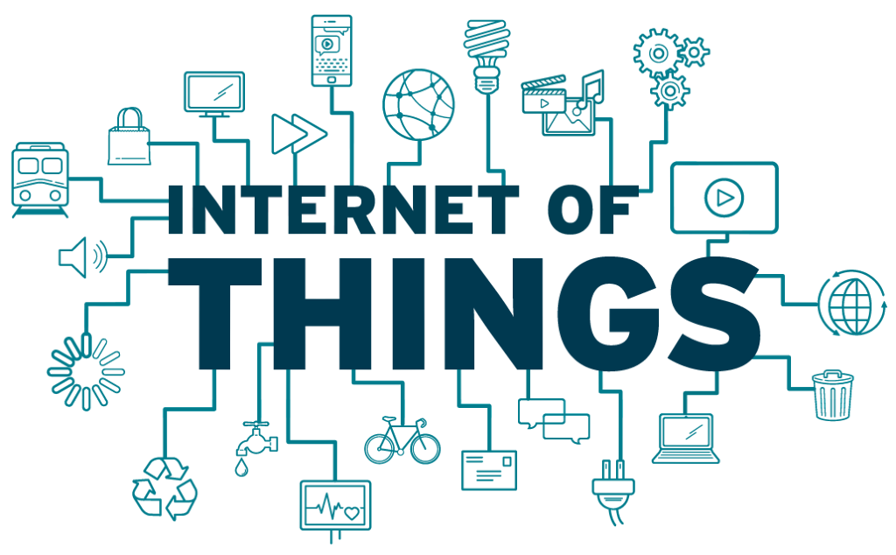
IoT (Internet of Things), What???
Let’s start by Understanding Individual words.
Internet, Things

Slide 7
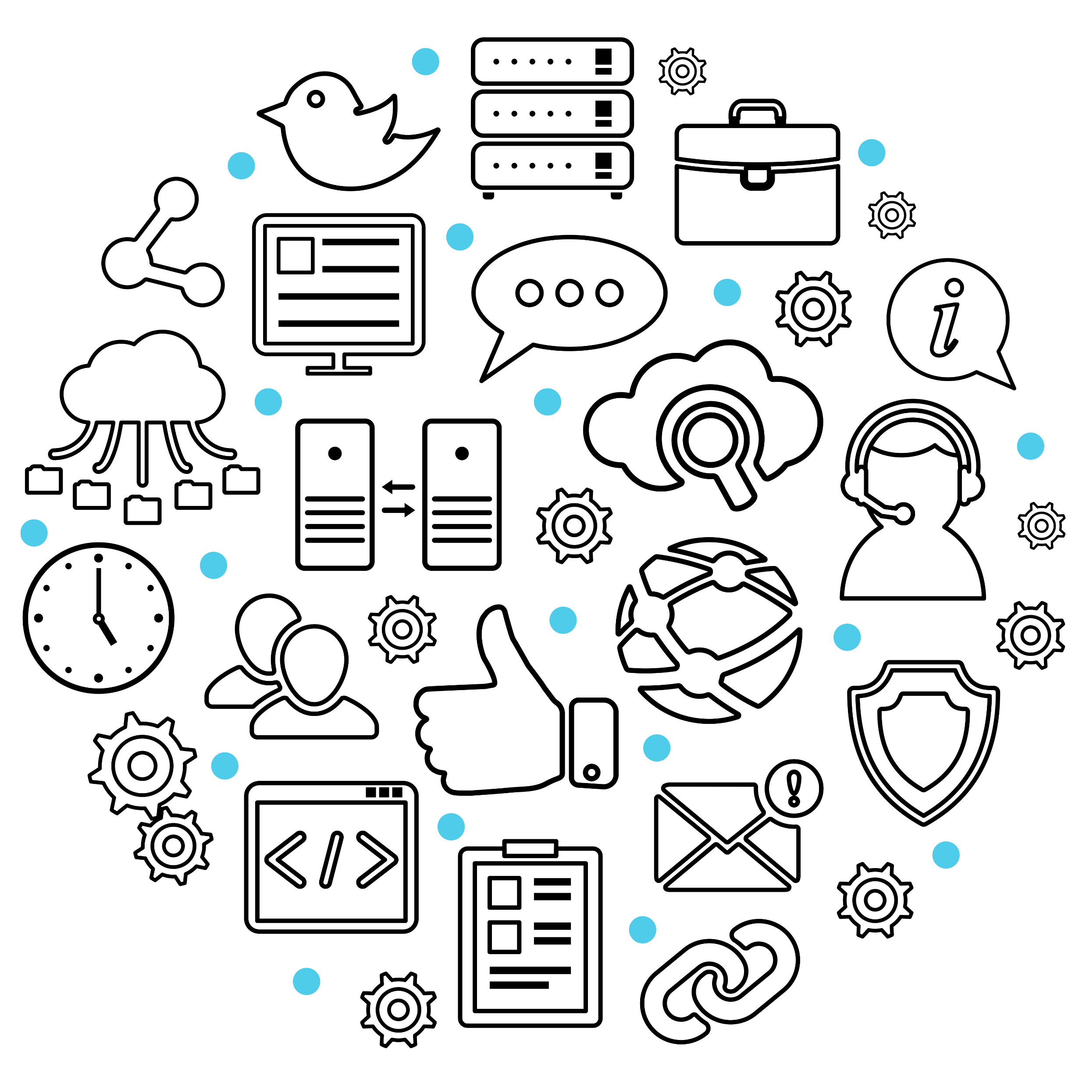
IoT (Internet of Things), What???
Okay, so we all have heard and also all are very familiar with the word “Internet”
It’s a network of interconnected Networks.
May be wired, may be wireless.
The main purpose is to transfer information between 2 similar or different type of devices.
Mostly the devices which are capable of computing (i.e. Mobile, laptops, desktops, servers etc.)

Slide 8
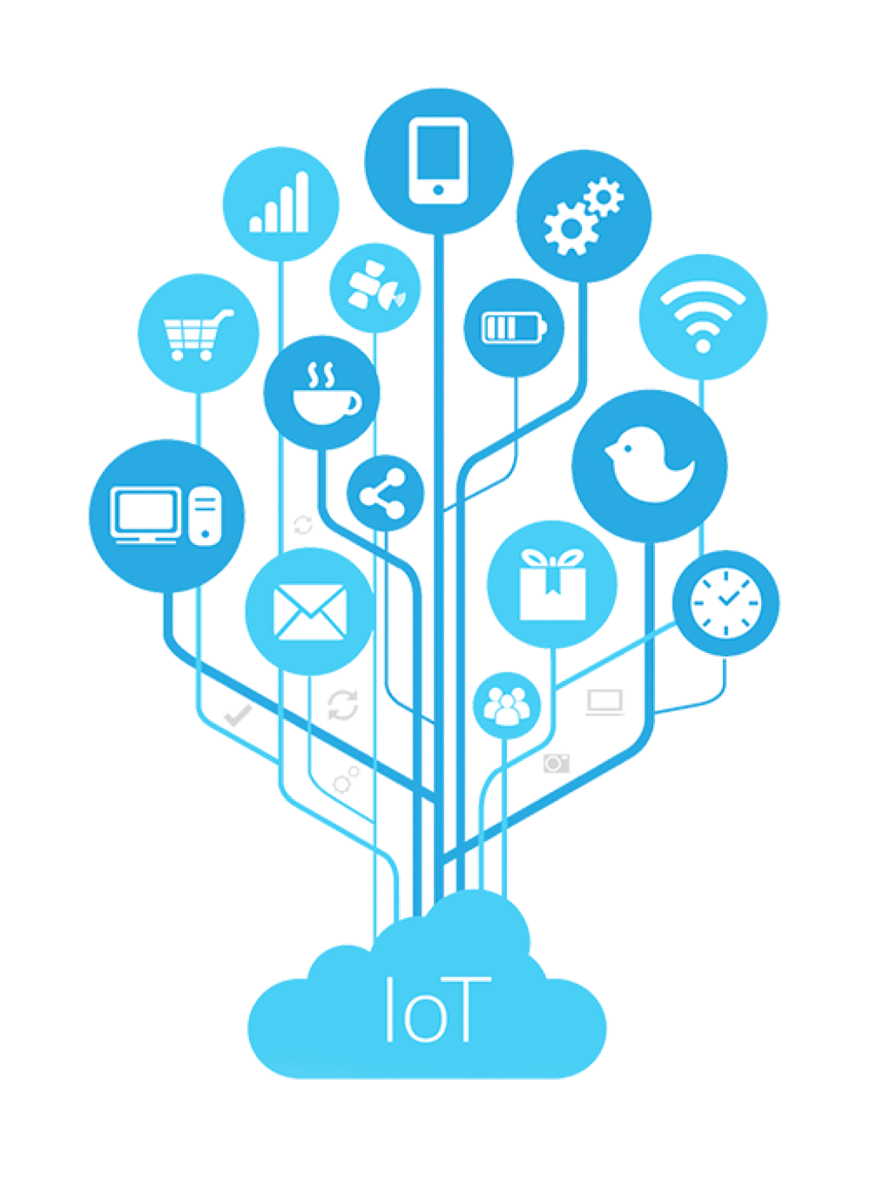
IoT (Internet of Things), What???
Extending that term to Internet of Things, one can define it in many ways but basically we can define IoT as, the network of interconnected computing devices (Internet) which are embedded in everyday objects (Things).
The primary goal of the Internet of Things is to enable these devices to communicate with each other and with central systems to make informed decisions and automate processes.

Slide 9
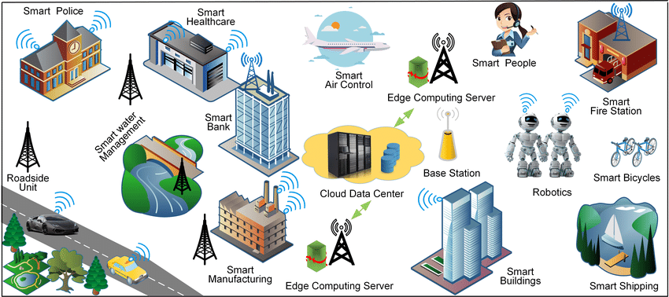
IoT (Internet of Things), What???

Slide 10
IoT Characteristics
Connectivity: IoT devices are linked through diverse communication technologies for seamless data exchange.
Intelligence and Identity: Each connected things needs to have its unique identity so the collected data can be processed accordingly.
Data Collection and Processing with intelligence: Devices gather and process data locally or transmit it for centralized analysis.
Data Integration and Analytics: IoT data is integrated into analytics platforms to derive meaningful insights and optimize processes.
Interoperability: Standardized protocols ensure devices from different manufacturers work together.
Architecture: There’s no homogeneous architecture but just a set of suggested layers as it is broad in nature and it is not owned by anyone

Slide 11
IoT Characteristics
Scalability (Horizontal and Vertical): IoT systems are designed to handle a growing number of connected devices efficiently as well as increasing processing power or storage.
Dynamicity and Self-adapting(Complexity): IoT devices should dynamically adapt themselves to the changing surroundings.
Remote Monitoring and Management: Devices can be monitored and managed remotely for maintenance and updates.
Real-time Operation: Many IoT applications require real-time or near-real-time processing for quick decision-making.
Energy Efficiency: Devices often operate on limited energy, emphasizing the importance of energy-efficient designs.
Security and Privacy: Robust measures like encryption, authentication, and access controls safeguard IoT systems and address privacy concerns.

Slide 12
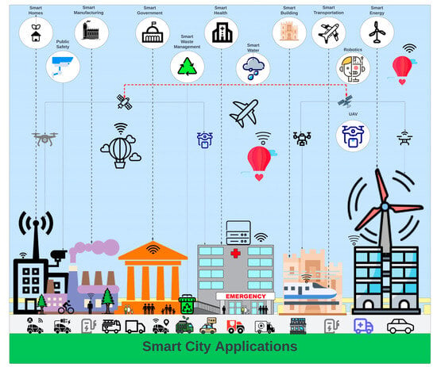
IoT Applications

Slide 13
IoT Applications
Smart Homes: IoT devices like smart thermostats, lights, security cameras, and voice-activated assistants enhance home automation, security, and energy efficiency.
Industrial IoT (IIoT): IoT is widely used in manufacturing for predictive maintenance, real-time monitoring of equipment, supply chain optimization, and overall process efficiency.
Healthcare: IoT devices, such as wearable fitness trackers, remote patient monitoring systems, and smart medical devices, enable improved healthcare management and personalized treatment.
Smart Cities: IoT contributes to urban development through applications like smart traffic management, waste management, environmental monitoring, and public safety systems.
Agriculture: Precision farming utilizes IoT for soil monitoring, crop health management, and automated irrigation, leading to increased efficiency and resource conservation.
Retail: IoT enhances the retail experience with technologies like RFID tags for inventory management, smart shelves, and personalized shopping experiences through beacons and sensors.
Transportation: IoT is crucial in smart transportation systems, including connected vehicles, traffic monitoring, fleet management, and logistics optimization.

Slide 14
IoT Applications
Energy Management: Smart grids and IoT-enabled devices help monitor and optimize energy consumption, contributing to efficient energy management and sustainability.
Environmental Monitoring: IoT sensors monitor environmental factors such as air and water quality, helping to address pollution and support conservation efforts.
Supply Chain Management: IoT provides real-time visibility into the supply chain, enabling better tracking, monitoring, and optimization of goods in transit.
Building Automation: IoT systems control and monitor building operations, including lighting, HVAC, security, and access control, for improved energy efficiency and security.
Wearable Technology: Fitness trackers, smartwatches, and other wearables utilize IoT for health monitoring, activity tracking, and personalized user experiences.
Water Management: IoT devices help monitor and manage water resources through smart irrigation, leak detection, and water quality monitoring.
Asset Tracking: Businesses use IoT for real-time tracking and monitoring of assets, whether in logistics, manufacturing, or healthcare.

Slide 15
Key Components in IoT System
Devices/Things: Physical objects or devices embedded with sensors, actuators, and communication capabilities. These devices collect-transmit data to the IoT system.
IoT Gateways: Devices that act as intermediaries between IoT devices and the cloud. They aggregate and preprocess data before transmitting it to the central system, improving efficiency and reducing bandwidth usage.
Middleware: Software that bridges the gap between devices and applications, facilitating communication, data management, and device control. Middleware ensures interoperability and seamless integration.
Cloud Services: Cloud platforms store and process data, providing scalable and flexible resources for analytics, storage, and application deployment.
Analytics and Machine Learning: Tools and algorithms that analyze the collected data, derive meaningful insights, and, in some cases, enable machine learning for predictive analytics and decision-making.
User Interface: The interface through which users interact with the IoT system, often in the form of dashboards or applications. Users can monitor, control, and receive insights from connected devices.

Slide 16
IoT Architecture
Data-Control Flow
Application Layer
Smart Application
As discussed earlier, IoT does not have a fixed architecture, rather some defined needs, which can be divided into various layers, forming a basic architecture.
The commonly used layers are:
  Sensing Layer
  Network Interface Layer
  Data Processing Layer
  Application Layer
Smart Applications
Data Processing Layer
Process Information
Processing Unit/Data Analysis
Network Layer
Data Transmission
Network Gateways
(Data Acquisition Technologies)
Sensing Layer
Data Gathering
Physical Objects, Sensors & Actuators

Slide 17
IoT Architecture: Sensing Layer
The bottommost layer, installed at the endpoint/hardware level.
Consists of:
  Sensors: Devices that measure physical parameters like temperature, motion, and light.
  Actuators: Devices enabling physical actions in response to collected data.
  Sensor Nodes: Devices with sensors, processing units, and communication capabilities.
  Sensor Networks: Connected nodes forming a network for data aggregation. Protocols like MQTT, LoRa or Zigbee are used.
  Edge Computing: Processing data on sensor nodes to reduce central system dependency.
  Power Management: Strategies to optimize power usage in battery-powered sensors.
  Data Preprocessing: Basic processing on sensor nodes before transmitting data.
  Localization Systems: Integration for accurate spatial information.

Slide 18
IoT Architecture: Network Layer
Layer responsible for facilitating communication between devices, sensors and the central system. Includes infrastructure & protocols to enable Data Transfer.
Consists of:
  Communication Protocols: Standardized protocols like MQTT, CoAP, and HTTP.
  Wireless Technologies: Wi-Fi, Bluetooth, Zigbee, LoRa, and cellular networks.
  Gateways: Devices that bridge local IoT devices to the cloud.
  Mesh Networks: Devices forming networks to relay data and enhance coverage.
  Routing and Switching: Infrastructure components directing data traffic efficiently.
  Security Measures: Encryption, authentication, and secure channels for data protection.
  Quality of Service (QoS): Policies to prioritize critical data traffic.
  Scalability: Design considerations for accommodating a growing number of devices.
  IPv6 Implementation: Larger address space for the increasing number of connected devices.
  Network Management: Tools for monitoring, managing, and troubleshooting the IoT network.
  Edge Computing Integration: Localized data processing for reduced latency.

Slide 19
IoT Architecture: Data Processing Layer
Handles analysis, interpretation and utilization of the data collected from sensors and devices.
Involves data processing into meaningful information useful for decision making.
  Data Storage: Storing collected data in databases or data warehouses.
  Data Processing Engines: Analyzing and transforming raw data into actionable insights.
  Analytics Tools: Platforms for advanced analytics, visualization, and reporting.
  Machine Learning Algorithms: Implementing models for predictive analytics.
  Complex Event Processing (CEP): Identifying and responding to real-time complex events.
  Normalization and Transformation: Standardizing data formats for consistency.
  Filtering and Aggregation: Discarding irrelevant data and aggregating relevant information.
  Security Measures: Implementing protocols to protect processed data.
  Batch Processing and Stream Processing: Handling data in batches or real-time streams.
  Rule Engines: Enforcing predefined rules and policies for automation.
  APIs and Interoperability: Providing interfaces for seamless integration.

Slide 20
IoT Architecture: Application Layer
User-facing Component, where end-users interact with IoT system.
Dashboard like, enabling users to monitor, control and derive insights from connected devices.
Consists of:
  User Interface (UI): Interaction point for users with web dashboards or mobile apps.
  Applications: Software delivering specific functionalities or services based on processed data.
  Dashboards: Visual representations for monitoring device status and performance.
  Reporting Tools: Generate reports and analytics for decision-making.
  Alerts and Notifications: Notify users based on predefined events or anomalies.
  Automation Systems: Implement automated actions in response to specific conditions.
  Integration with Third-Party Services: Seamless integration with external platforms.
  Customization and Personalization: Tailor the IoT experience to user preferences.
  Application Programming Interfaces (APIs): Provide interfaces for external system integration.
  Scalability: Design for accommodating a growing number of users and devices.
  User Authentication and Access Control: Security mech. for user verification and access control.
  Feedback Mechanisms: Gather user feedback to improve the overall experience

Slide 21
IoT Challenges: Design Challenges
Various design challenges are faced while developing an IoT system
  Connectivity:
    Network must be available as per the required range
    Usually 2.4 GHz or 5 GHz band is used, as it is freely available
  Power Requirements:
    Sometimes IoT devices are placed at some remote location, hence are battery operated, so the power requirements must be taken into consideration for longer battery life.
  Storage and Computational Capabilities:
    Remote device usually struggle with the computational power and storage capacity, so the software needs to be optimised in a way that it can work with these constraints.

Slide 22
IoT Challenges: Design Challenges
Various design challenges are faced while developing an IoT system
  Complexity:
    Various Engineering field knowledge is required to build an IoT system making it a complex system to understand.
    The toolkits, software and hardware are not abundant and real skill is required to build an application.
  Data Extraction from complex environment:
    If the environment is complex then changing conditions may affect the working capability of the sensor, this factor must be taken into consideration.
    Also that environment must have Internet connectivity so the data can be transmitted continuously for monitoring and extraction.

Slide 23
IoT Challenges: Security Challenges
A large part of IoT covers transmission and collection of some useful data over various environments & networks. This involves security challenges.
  Security & Personal Safety:
    Weak or unencrypted communication between IoT devices and the network may expose data to interception or manipulation.
    Weak authentication mechanisms or default credentials may make it easier for unauthorized entities to access IoT devices.
    Inadequate authorization controls may result in unauthorized actions or data access.
    Insecure network configurations, such as open ports or weak network segmentation, may expose IoT devices to external attacks.
    Lack of proper network monitoring can hinder the detection of malicious activities.
  Privacy:
    The vast amount of data generated by IoT devices, often of a sensitive nature, raises concerns about data privacy.
    Inadequate data anonymization and protection may lead to privacy breaches.

